Slide 1
CPSC614: Graduate Computer Architecture
I/O 2: Failure Terminology, Examples,
Gray Paper and a little Queueing Theory prof. Lawrence Rauchwerger
Based on lectures by
Prof. David A. Patterson
UC Berkeley

Slide 2
Review Storage
Disks:
  Extraodinary advance in capacity/drive, $/GB
  Currently 17 Gbit/sq. in. ; can continue past 100 Gbit/sq. in.?
  Bandwidth, seek time not keeping up: 3.5 inch form factor makes sense? 2.5 inch form factor in near future? 1.0 inch form factor in long term?
Tapes
  No investment, must be backwards compatible
  Are they already dead?
  What is a tapeless backup system?

Slide 3
Review: RAID Techniques: Goal was performance, popularity due to reliability of storage
• Disk Mirroring, Shadowing (RAID 1)
1
0
0
1
0
0
1
1
1
0
0
1
0
0
1
1
Each disk is fully duplicated onto its "shadow"
Logical write = two physical writes
100% capacity overhead
• Parity Data Bandwidth Array (RAID 3)
1
0
0
1
0
0
1
1
1
1
0
0
1
1
0
1
1
0
0
1
0
0
1
1
0
0
1
1
0
0
1
0
Parity computed horizontally
Logically a single high data bw disk
• High I/O Rate Parity Array (RAID 5)
Interleaved parity blocks
Independent reads and writes
Logical write = 2 reads + 2 writes

Slide 4
Outline
Reliability Terminology
Examlpes
Discuss Jim Gray’s Turing paper

Slide 5
Definitions
Examples on why precise definitions so important for reliability
Is a programming mistake a fault, error, or failure?
  Are we talking about the time it was designed
  or the time the program is run?
  If the running program doesn’t exercise the mistake,
  is it still a fault/error/failure?
If an alpha particle hits a DRAM memory cell, is it a fault/error/failure if it doesn’t change the value?
  Is it a fault/error/failure if the memory doesn’t access the changed bit?
  Did a fault/error/failure still occur if the memory had error correction and delivered the corrected value to the CPU?

Slide 6
IFIP Standard terminology
Computer system dependability: quality of delivered service such that reliance can be placed on service
Service is observed actual behavior as perceived by other system(s) interacting with this system’s users
Each module has ideal specified behavior, where service specification is agreed description of expected behavior
A system failure occurs when the actual behavior deviates from the specified behavior
failure occurred because an error, a defect in module
The cause of an error is a fault
When a fault occurs it creates a latent error, which becomes effective when it is activated
When error actually affects the delivered service, a failure occurs (time from error to failure is error latency)

Slide 7
Fault v. (Latent) Error v. Failure
A fault creates one or more latent errors
Properties of errors are
  a latent error becomes effective once activated
  an error may cycle between its latent and effective states
  an effective error often propagates from one component to another, thereby creating new errors
Effective error is either a formerly-latent error in that component or it propagated from another error
A component failure occurs when the error affects the delivered service
These properties are recursive, and apply to any component in the system
An error is manifestation in the system of a fault,
a failure is manifestation on the service of an error

Slide 8
Fault v. (Latent) Error v. Failure
An error is manifestation in the system of a fault,
a failure is manifestation on the service of an error
Is a programming mistake a fault, error, or failure?
  Are we talking about the time it was designed
  or the time the program is run?
  If the running program doesn’t exercise the mistake,
  is it still a fault/error/failure?
A programming mistake is a fault
the consequence is an error (or latent error) in the software
upon activation, the error becomes effective
when this effective error produces erroneous data which affect the delivered service, a failure occurs

Slide 9
Fault v. (Latent) Error v. Failure
An error is manifestation in the system of a fault,
a failure is manifestation on the service of an error
Is If an alpha particle hits a DRAM memory cell, is it a fault/error/failure if it doesn’t change the value?
  Is it a fault/error/failure if the memory doesn’t access the changed bit?
  Did a fault/error/failure still occur if the memory had error correction and delivered the corrected value to the CPU?
An alpha particle hitting a DRAM can be a fault
if it changes the memory, it creates an error
error remains latent until effected memory word is read
if the effected word error affects the delivered service, a failure occurs

Slide 10
Fault v. (Latent) Error v. Failure
An error is manifestation in the system of a fault,
a failure is manifestation on the service of an error
What if a person makes a mistake, data is altered, and service is affected?
fault:
error:
latent:
failure:

Slide 11
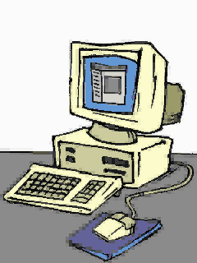
Fault Tolerance vs Disaster Tolerance
Fault-Tolerance (or more properly, Error-Tolerance): mask local faults
(prevent errors from becoming failures)
  RAID disks
  Uninterruptible Power Supplies
  Cluster Failover
Disaster Tolerance: masks site errors
(prevent site errors from causing service failures)
  Protects against fire, flood, sabotage,..
  Redundant system and service at remote site.
  Use design diversity
From Jim Gray’s “Talk at UC Berkeley on Fault Tolerance " 11/9/00
Notes:
There have been a variety of technologies introduced to address your growing need for high-availability servers.
The simplest of these is Data Mirroring, which continuously duplicates all disk writes onto a mirrored set of disks, possibly at a remote disaster recovery site. Today you can get Data Mirroring products for Windows NT Server from a few vendors, including Octopus (http://www.octopus.com) and Vinca (http://www.vinca.com). These solutions provide excellent protection for your data, even in the event of a metropolis-wide disaster. However, they’re not high-availability solutions that have the ability to detect all types of hardware or software failure, and they have at best limited abilities to automatically restart applications. (For example, users must manually reconnect to the new server, plus any applications running on the recovery server are canceled as if it had been the server that failed.)
Server Mirroring like Novell SFT III (Server Fault Tolerance) is a high-availability capability that both protects your data and provides for automatic detection of failures plus restart of selected applications. Server Mirroring provides excellent reliability, but at a very high cost since it requires an idle “standby” server that does no productive work except when the primary server fails. There are also very few applications which can take advantage of proprietary server mirroring solutions like Novell SFT III.
At the high end are true “fault tolerant” systems like the excellent “NonStop” systems from Tandem. These systems are able to detect and almost instantly recover from virtually any single hardware or software failure. Most bank transactions, for example, run on this type of system. This level of reliability comes with a very high price tag, however, and each solution is based on a proprietary, single-vendor set of hardware.
And, finally, there’s another high-availability technology which seems to offer the best of all these capabilities: clustering...

Slide 12
CS 252 Administrivia
Send 1-2 paragraph summary of papers to Yu-jia Jin (yujia@ic.eecs) BEFORE CLASS Wednesday
  Hennessy, J. "The future of systems research."
  Should have already turned in
    G. MOORE, "Cramming More Components onto Integrated Circuits"
    J. S. LIPTAY, "Structural Aspects of the System/360 Model 85, Part II: The Cache"
    J.GRAY, Turing Award Lecture: "What Next? A dozen remaining IT problems"
Please fill out Third Edition chapter surveys for 6 by next Wednesday; 1,5 should be done
  http://www.mkp.com/hp3e/quest-student.asp
Project suggestions are on web site; start looking
  http://www.cs.berkeley.edu/~pattrsn/252S01/suggestions.html
Office hours Wednesdays 11-12

Slide 13
Defining reliability and availability quantitatively
Users perceive a system alternating between 2 states of service with respect to service specification:
  1. service accomplishment, where service is delivered as specified,
  2. service interruption, where the delivered service is different from the specified service, measured as Mean Time To Repair (MTTR)
  Transitions between these 2 states are caused by
  failures (from state 1 to state 2) or restorations (2 to 1)
module reliability: a measure of continuous service accomplishment (or of time to failure) from a reference point, e.g, Mean Time To Failure (MTTF)
  The reciprocal of MTTF is failure rate
module availability: measure of service accomplishment with respect to alternation between the 2 states of accomplishment and interruption
= MTTF / (MTTF+MTTR)

Slide 14
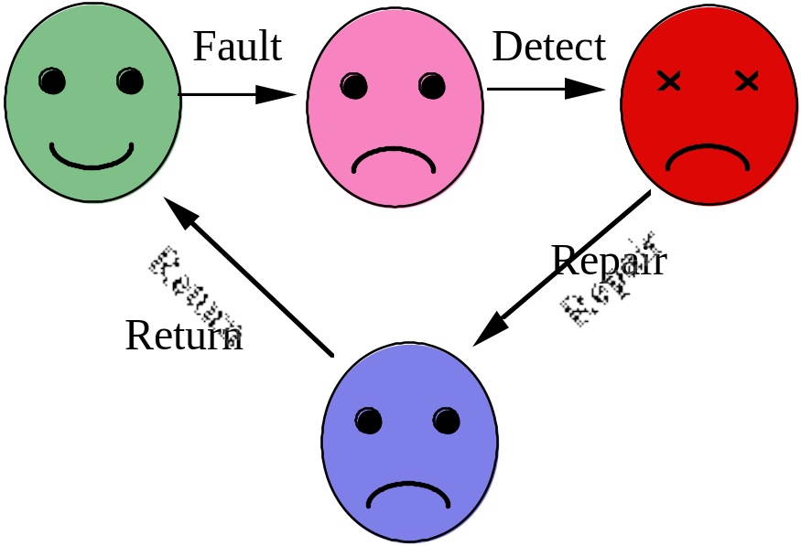
Fail-Fast is Good, Repair is Needed
Lifecycle of a module
fail-fast gives
short fault latency
High Availability
is low UN-Availability
Unavailability ­ ^{MTTR}
MTTF+MTTR
As MTTF>>MTTR, improving either MTTR or MTTF gives benefit
Note: Mean Time Between Failures (MTBF)= MTTF+MTTR
From Jim Gray’s “Talk at UC Berkeley on Fault Tolerance " 11/9/00

Slide 15
Dependability: The 3 ITIES
Reliability / Integrity:
does the right thing.
(Also large MTTF)
Availability: does it now.
(Also small MTTR
MTTF+MTTR
System Availability:
if 90% of terminals up & 99% of DB up?
(=>89% of transactions are serviced on time).
Integrity
Security
Reliability
Availability
From Jim Gray’s “Talk at UC Berkeley on Fault Tolerance " 11/9/00

Slide 16
Reliability Example
If assume collection of modules have exponentially distributed lifetimes (age of compoent doesn't matter in failure probability) and modules fail independently, overall failure rate of collection is sum of failure rates of modules
Calculate MTTF of a disk subsystem with
  10 disks, each rated at 1,000,000 hour MTTF
  1 SCSI controller, 500,000 hour MTTF
  1 power supply, 200,000 hour MTTF
  1 fan, 200,000 MTTF
  1 SCSI cable, 1,000,000 hour MTTF
Failure Rate = 10*1/1,000,000 + 1/500,000
+ 1/200,000 + 1/200,000 + 1/1,000,000
= (10 +2 +5 +5 +1)/1,000,000 = 23/1,000,000
MTTF=1/Failure Rate = 1,000,000/23 = 43,500 hrs

Slide 17
What's wrong with MTTF?
1,000,000 MTTF > 100 years; ~ infinity?
How calculated?
  Put, say, 2000 in a room, calculate failures in 60 days, and then calculate the rate
  As long as <=3 failures => 1,000,000 hr MTTF
Suppose we did this with people?
1998 deaths per year in US ("Failure Rate")
Deaths 5 to 14 year olds = 20/100,000
MTTF_{human} = 100,000/20 = 5,000 years
Deaths >85 year olds = 20,000/100,000
MTTF_{human} = 100,000/20,000 = 5 years
source: "Deaths: Final Data for 1998," www.cdc.gov/nchs/data/nvs48_11.pdf

Slide 18
What's wrong with MTTF?
1,000,000 MTTF > 100 years; ~ infinity?
But disk lifetime is 5 years!
=> if you replace a disk every 5 years, on average it wouldn't fail until 21st replacement
A better unit: % that fail
Fail over lifetime if had 1000 disks for 5 years
= (1000 disks * 365*24) / 1,000,000 hrs/failure
= 43,800,000 / 1,000,000 = 44 failures
= 4.4% fail with 1,000,000 MTTF
Detailed disk spec lists failures/million/month
Typically about 800 failures per month per million disks at 1,000,000 MTTF,
or about 1% per year for 5 year disk lifetime

Slide 19
Dependability Big Idea: No Single Point of Failure
Since Hardware MTTF is often 100,000 to 1,000,000 hours and MTTF is often 1 to 10 hours, there is a good chance that if one component fails it will be repaired before a second component fails
Hence design systems with sufficient redundancy that there is No Single Point of Failure

Slide 20
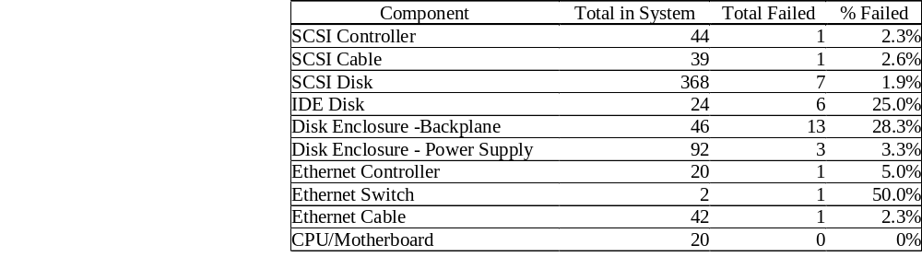
HW Failures in Real Systems: Tertiary Disks
A cluster of 20 PCs in seven 7-foot high, 19-inch wide racks with 368 8.4 GB, 7200 RPM, 3.5-inch IBM disks. The PCs are P6-200MHz with 96 MB of DRAM each. They run FreeBSD 3.0 and the hosts are connected via switched 100 Mbit/second Ethernet

Slide 21
When To Repair?
Chances Of Tolerating A Fault are 1000:1 (class 3)
A 1995 study: Processor & Disc Rated At ~ 10khr MTTF
Computed Single Observed
Failures Double Fails Ratio
10k Processor Fails 14 Double ~ 1000 : 1
40k Disc Fails, 26 Double ~ 1000 : 1
Hardware Maintenance:
On-Line Maintenance "Works" 999 Times Out Of 1000.
The chance a duplexed disc will fail during maintenance?1:1000
Risk Is 30x Higher During Maintenance
=> Do It Off Peak Hour
Software Maintenance:
Repair Only Virulent Bugs
Wait For Next Release To Fix Benign Bugs
From Jim Gray’s “Talk at UC Berkeley on Fault Tolerance " 11/9/00

Slide 22
Sources of Failures
MTTF MTTR
Power Failure: 2000 hr 1 hr
Phone Lines
Soft >.1 hr .1 hr
Hard 4000 hr 10 hr
Hardware Modules: 100,000hr 10hr (many are transient)
Software:
1 Bug/1000 Lines Of Code (after vendor-user testing)
=> Thousands of bugs in System!
Most software failures are transient: dump & restart system.
Useful fact: 8,760 hrs/year ~ 10k hr/year
From Jim Gray’s “Talk at UC Berkeley on Fault Tolerance " 11/9/00

Slide 23
Case Study - Japan
"Survey on Computer Security", Japan Info Dev Corp., March 1986. (trans: Eiichi Watanabe).
Vendor
4
2
%
Tele Comm lines
1
2
%
1
1
.
2
Environment
2
5
%
%
Application
Software
9
.
3
%
Operations
Vendor (hardware and software) 5 Months
Application software 9 Months
Communications lines 1.5 Years
Operations 2 Years
Environment 2 Years
10 Weeks
1,383 institutions reported (6/84 - 7/85)
7,517 outages, MTTF ~ 10 weeks, avg duration ~ 90 MINUTES
To Get 10 Year MTTF, Must Attack All These Areas
From Jim Gray’s “Talk at UC Berkeley on Fault Tolerance " 11/9/00

Slide 24
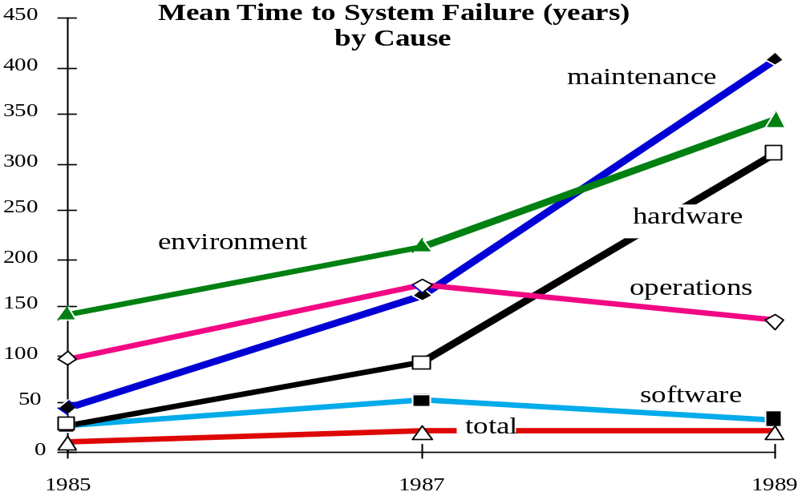
Case Studies - Tandem Trends
Reported MTTF by Component
1985 1987 1990
SOFTWARE 2 53 33 Years
HARDWARE 29 91 310 Years
MAINTENANCE 45 162 409 Years
OPERATIONS 99 171 136 Years
ENVIRONMENT 142 214 346 Years
SYSTEM 8 20 21 Years
Problem: Systematic Under-reporting
From Jim Gray’s “Talk at UC Berkeley on Fault Tolerance " 11/9/00

Slide 25
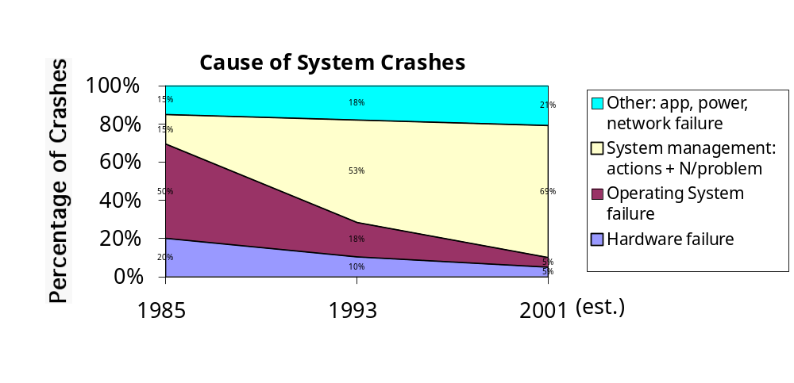
Is Maintenance the Key?
Rule of Thumb: Maintenance 10X HW
  so over 5 year product life, ~ 95% of cost is maintenance
VAX crashes ‘85, ‘93 [Murp95]; extrap. to ‘01
Sys. Man.: N crashes/problem, SysAdmin action
  Actions: set params bad, bad config, bad app install
HW/OS 70% in ‘85 to 28% in ‘93. In ‘01, 10%?
Notes:
[Murp95] Murphy, B.; Gent, T. Measuring system and software reliability using an automated data collection process. Quality and Reliability Engineering International, vol.11, (no.5), Sept.-Oct. 1995. p.341-53.

Slide 26
OK: So Far
Hardware fail-fast is easy
Redundancy plus Repair is great (Class 7 availability)
Hardware redundancy & repair is via modules.
How can we get instant software repair?
We Know How To Get Reliable Storage
RAID Or Dumps And Transaction Logs.
We Know How To Get Available Storage
Fail Soft Duplexed Discs (RAID 1...N).
? How do we get reliable execution?
? How do we get available execution?
From Jim Gray’s “Talk at UC Berkeley on Fault Tolerance " 11/9/00

Slide 27
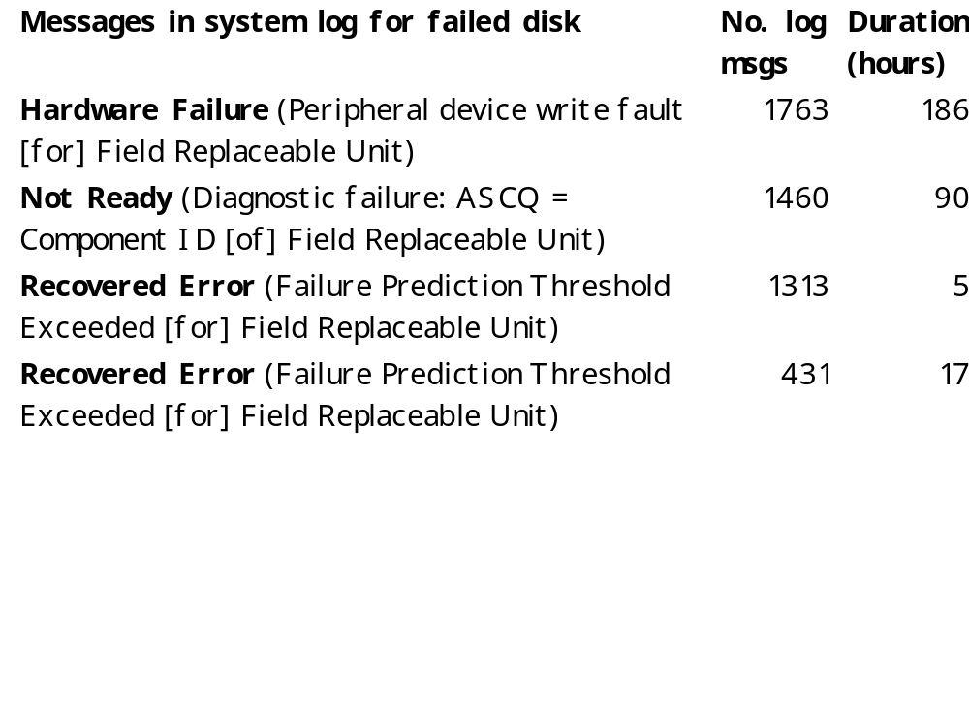
Does Hardware Fail Fast? 4 of 384 Disks that failed in Tertiary Disk

Slide 28
High Availability System Classes
Goal: Build Class 6 Systems
Unavailable
(min/year)
50,000
5,000
500
50
5
.5
.05
Availability
90.%
99.%
99.9%
99.99%
99.999%
99.9999%
99.99999%
Availability
Class
1
2
3
4
5
6
7
System Type
Unmanaged
Managed
Well Managed
Fault Tolerant
High-Availability
Very-High-Availability
Ultra-Availability
UnAvailability = MTTR/MTBF
can cut it in ½ by cutting MTTR or MTBF
From Jim Gray’s “Talk at UC Berkeley on Fault Tolerance " 11/9/00

Slide 29
How Realistic is "5 Nines"?
HP claims HP-9000 server HW and HP-UX OS can deliver 99.999% availability guarantee “in certain pre-defined, pre-tested customer environments”
  Application faults?
  Operator faults?
  Environmental faults?
Collocation sites (lots of computers in 1 building on Internet) have
  1 network outage per year (~1 day)
  1 power failure per year (~1 day)
Microsoft Network unavailable recently for a day due to problem in Domain Name Server: if only outage per year, 99.7% or 2 Nines

Slide 30
Demo: looking at some nodes
Look at http://uptime.netcraft.com/
Internet Node availability:
92% mean,
97% median
Darrell Long (UCSC)
ftp://ftp.cse.ucsc.edu/pub/tr/
  ucsc-crl-90-46.ps.Z "A Study of the Reliability of Internet Sites"
  ucsc-crl-91-06.ps.Z "Estimating the Reliability of Hosts Using the Internet"
  ucsc-crl-93-40.ps.Z "A Study of the Reliability of Hosts on the Internet"
  ucsc-crl-95-16.ps.Z "A Longitudinal Survey of Internet Host Reliability"
From Jim Gray’s “Talk at UC Berkeley on Fault Tolerance " 11/9/00

Slide 31
Discuss Gray's Paper
"What Next? A dozen remaining IT problems," June 1999, MS-TR-99-50
http://research.microsoft.com/~gray/papers/MS_TR_99_50_TuringTalk.pdf

Slide 32
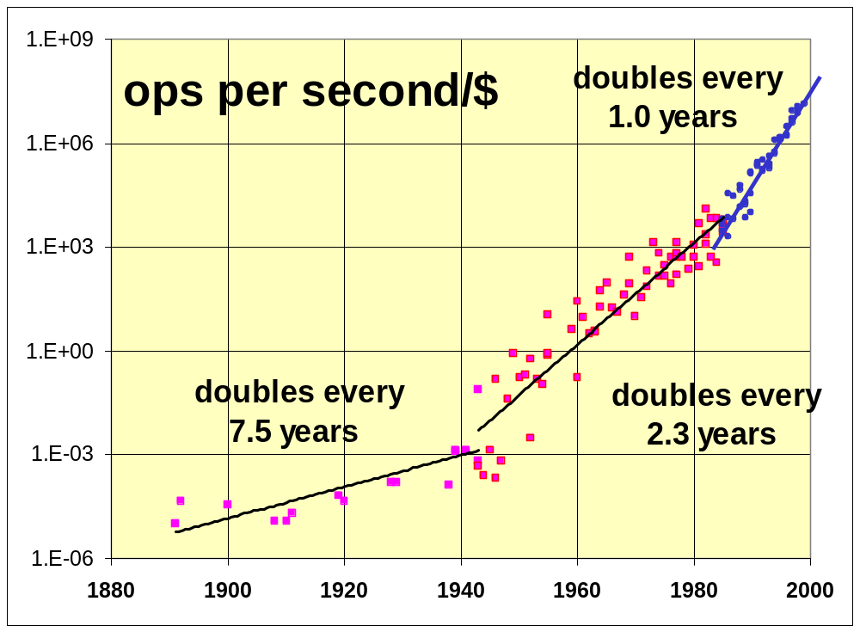
ops/s/$ Had Three Growth Curves
1890-1990
Combination of Hans Moravac + Larry Roberts + Gordon Bell
WordSize*ops/s/sysprice
1890-1945
  Mechanical
  Relay
  7-year doubling
1945-1985
  Tube, transistor,..
  2.3 year doubling
1985-2000
  Microprocessor
  1.0 year doubling
Notes:
Here is a chart of how things have changed since Babbage’s time. Lets measure the price-performance of these systems. Larry Roberts has a metric of ops/second * bytes/ system price. In 1969 he observed that this metric was doubling about every 18 months. This was contemporaneous with Gordon Moore’s observation about silicon, but was measured at the system level. Using some data from Hans’ Moravac’s web site XXXX, we plotted the data from Herman Hollerith forward. Between 1890 and 1945, systems were either mechanical or electro-mechanical. Their performance doubled about every seven years. Then computing shifted to tubes and transistors and the doubling time dropped to 2.3 years. In 1985, microprocessors came on the scene. Through a combination of lower systems prices and much faster machines, the doubling time has dropped to 1 year.
This acceleration in price/performance is astonishing, and it changes the rules. Similar graphs apply to the cost of storage and bandwidth.

Slide 33
The List (Red is AI Complete)
Devise an architecture that scales up by 10^6.
The Turing test: win the impersonation game 30% of the time.
  3.Read and understand as well as a human.
  4.Think and write as well as a human.
Hear as well as a person (native speaker): speech to text.
Speak as well as a person (native speaker): text to speech.
See as well as a person (recognize).
  Illustrate as well as a person (done!) but virtual reality is still a major challenge.
Remember what is seen and heard and quickly return it on request.
Build a system that, given a text corpus, can answer questions about the text and summarize it as quickly and precisely as a human expert. Then add sounds: conversations, music. Then add images, pictures, art, movies.
Simulate being some other place as an observer (Tele-Past) and a participant (Tele-Present).
Build a system used by millions of people each day but administered by a ½ time person.
Do 9 and prove it only services authorized users.
Do 9 and prove it is almost always available: (out less than 1 second per 100 years).
Automatic Programming: Given a specification, build a system that implements the spec. Prove that the implementation matches the spec. Do it better than a team of programmers.

Slide 34

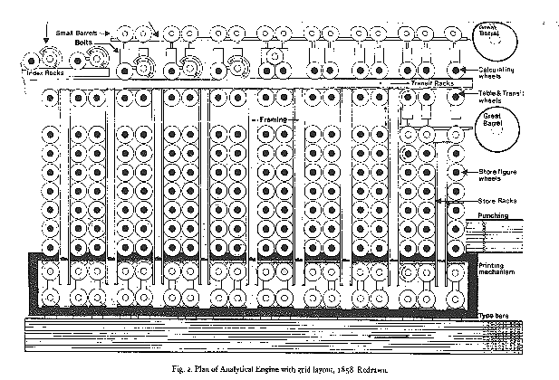
Trouble-Free Systems
Manager
  Sets goals
  Sets policy
  Sets budget
  System does the rest.
Everyone is a CIO (Chief Information Officer)
Build a system
  used by millions of people each day
  Administered and managed by a ½ time person.
    On hardware fault, order replacement part
    On overload, order additional equipment
    Upgrade hardware and software automatically.
Notes:
Server systems are more complex. They have some semi-custom applications, they have much heavier load, and often they provide the very services the PDAs, appliances, and desktops depend on. To some extent, the complexity has not disappeared, it has just moved.
But people who own servers are going to own many of them. They do not mind managing the server content, that is their business. But, they do not want to be systems management experts.
So, server systems should be self managing. The human systems manager should set goals, polices and budget. The system should do the rest. It should distribute work among the servers, when new ones arrive, they should just add to the cluster when they are plugged in. When a server fails, its storage will have been replicated somewhere else, so the storage and computation can move to those new locations.
The operational test for this systems is that it serves millions of people each day, and yet it is managed by a fraction of a person who does all the administrative tasks. Currently, such a system would need 24-hour a day coverage by a substantial staff. With special expertise required for upgrades, maintenance, system growth, database administration, backups, network management, and the like.

Slide 35
Trustworthy Systems
Build a system used by millions of people that
  Only services authorized users
    Service cannot be denied (can’t destroy data or power).
    Information cannot be stolen.
  Is always available: (out less than 1 second per 100 years = 8 9’s of availability)
    1950’s 90% availability,
    Today 99% uptime for web sites,
    99.99% for well managed sites (50 minutes/year)
    3 extra 9s in 45 years.
    Goal: 5 more 9s: 1 second per century.
  And prove it.
Notes:
Two issues that are hiding in the previous requirements deserve special attention. There have been a rash of security problems recently: Melissa, Chernobyl, and now a mathematical attack on RSA that makes 512 bit keys seem dangerously small.
We cannot trust our assets to cyberspace if this continues. So, a major challenge for systems designers is to develop a system which only services authorized uses. Service cannot be denied. Attackers cannot destroy data, nor can they force the system to deny service to authorized uses. Moreover, users cannot see data unless they are so authorized.
The added hook here is that most systems are penetrated by stealing passwords and entering as an authorized user. Any authentication based on passwords or other tokens seems too insecure. I believe we will have to go to physio-metric means like retinal scans or some other unforgivable authenticator.
The operational test for this challenge is that a tiger team cannot penetrate the system. But, unfortunately, that test does not really prove security. So this is one of those instances where the security system must rest on a proof that it is secure, and that all the threats are known and are guarded against.
The next attribute is that the system should always be available. We have gone from 90% availability in the 1950s to 99.99% availability today for well managed systems (web uses experience about 99% availability due to the fragile nature of the web, its protocols, and the current emphasis on time-to-market.
Nonetheless, we have picked up one thee 9s in 45 years, or about 15 years per nine. We should aim for 5 more 9s: an expectation of one second outage in a century. This is an extreme goal, but it seems quite achievable if hardware is very cheap and bandwidth is very high. One can replicate the data in many places, use transactions to manage the data consistency, use design diversity to avoid common mode failures, and quickly repair nodes when they fail.

Slide 36
Summary: Dependability
Fault => Latent errors in system => Failure in service
Reliability: quantitative measure of time to failure (MTTF)
  Assuming expoentially distributed independent failures, can calculate MTTF system from MTTF of components
Availability: quantitative measure % of time delivering desired service
Can improve Availability via greater MTTF or smaller MTTR (such as using standby spares)
No single point of failure a good hardware guideline, as everything can fail
Components often fail slowly
Real systems: problems in maintenance, operation as well as hardware, software

